Slide 1
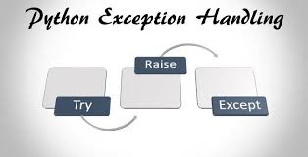
Exception Handling errors that happens during the execution of a program that could be handled

Slide 2
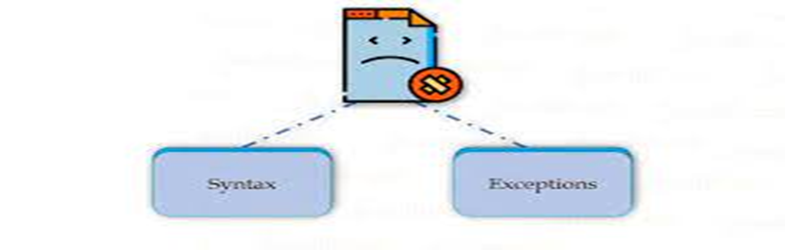
Errors in Programming Errors are the problem or fault occurs in the program that make the behavior of the program abnormal
We consider two types of errors mainly
Syntax Errors : mistake in coding structure, can’t ignore or handled
Exceptions : during the execution, can be handled.

Slide 3
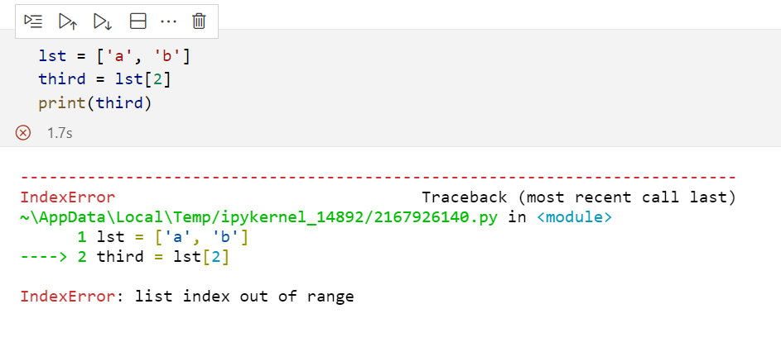
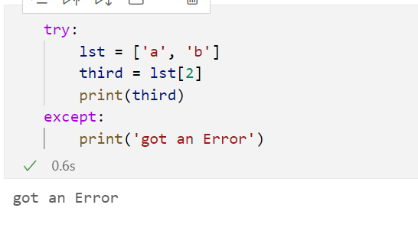
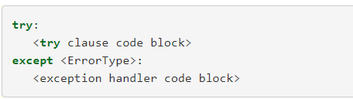
Handling an Exception: Flow of control
1. try-except

Slide 4
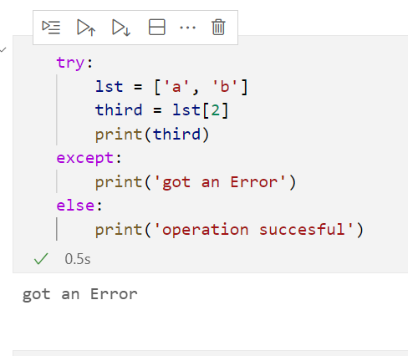
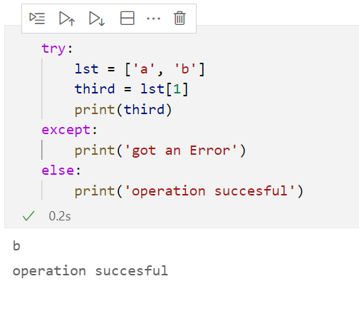
2. try-except-else
With Exception
No Exception

Slide 5
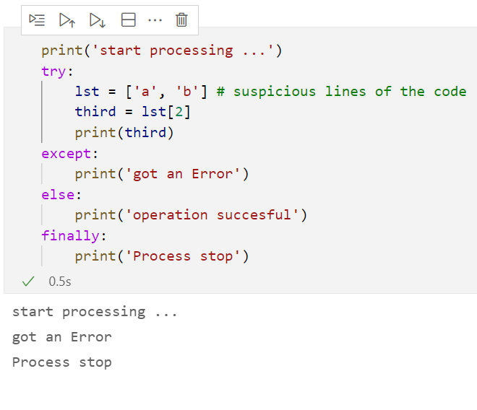
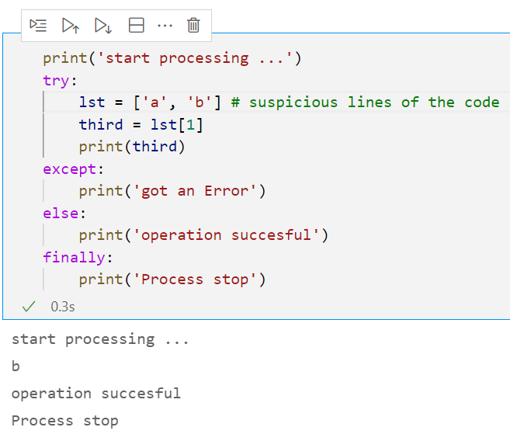
3. try-except-else-finally or try-except-finally
With Exception
No Exception

Slide 6
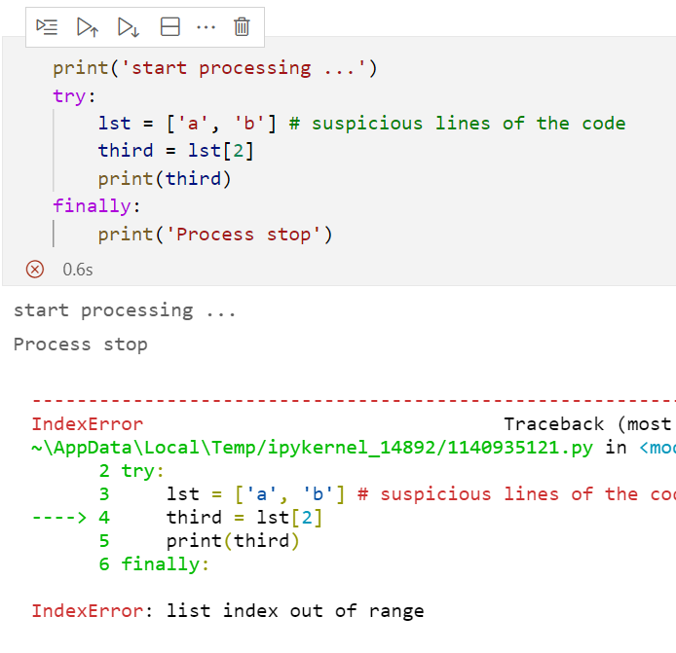
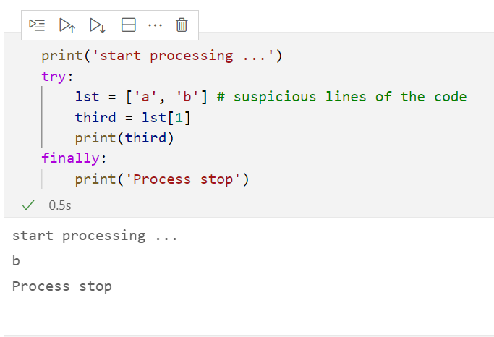
4. try-finally: In this combination we don’t handle
the exceptions but important lines we can run.
With Exception
No Exception

Slide 7
Standard Exception in Python3
Here is a list all the standard Exceptions available in Python −
Exception
Base class for all exceptions
ZeroDivisionError
Raised when division or modulo by zero takes place for all numeric types.
AttributeError
Raised in case of failure of attribute reference or assignment.
EOFError
Raised when there is no input from either the raw_input() or input() function and the end of file is reached.
ImportError
Raised when an import statement fails.
StopIteration
Raised when the next() method of an iterator does not point to any object.
ArithmeticError
Base class for all errors that occur for numeric calculation.

Slide 8
Continue…
KeyboardInterrupt
Raised when the user interrupts program execution, usually by pressing Ctrl+c.
IndexError
Raised when an index is not found in a sequence.
KeyError
Raised when the specified key is not found in the dictionary.
NameError
Raised when an identifier is not found in the local or global namespace.
UnboundLocalError
Raised when trying to access a local variable in a function or method but no value has been assigned to it.
IOError
Raised when an input/ output operation fails, such as the print statement or the open() function when trying to open a file that does not exist
TypeError
Raised when an operation or function is attempted that is invalid for the specified data type.
ValueError
Raised when the built-in function for a data type has the valid type of arguments, but the arguments have invalid values specified.

Slide 9
Multiple except blocks
try:
statement(s)
except Exception1:
statement
except Exception2:
statement
except Exception3:
statement

Slide 10
Multiple Exceptions in a Single except block
try:
n=int(input(‘Enter the number’))
print(n**2)
except (KeyboardInterrupt, ValueError,TypeError):
print(“Please Check before you enter”)
print(“Bye”)

Slide 11
1. ZeroDivisionError
a=int(input(‘Enter the number’))
b=int(input(‘Enter the number’))
try:
c=a/b
print(c)
except ZeroDivisionError as e:
print(“Please Check Denominator ”,e)
print(“Bye”)

Slide 12
2. ValueError
try:
n=int(input(‘Enter the number’))
print(n**2)
except ValueError as e:
print(“Please Check before you enter ”,e)
print(“Bye”)

Slide 13
3. KeyboardInterrupt
try:
n=int(input(‘Enter the number’))
print(n**2)
except KeyboardInterrupt as e:
print(“Do not press ctrl+c ”,e)
print(“Bye”)

Slide 14
4. TypeError
try:
n=int(input(‘Enter the number’))
print(n**2+’Hello’)
except TypeError as e:
print(“Please Check the datatype in expression”,e)
print(“Bye”)

Slide 15
5. FileNotFoundError
fname=input(“Enter the filename”)
try:
fp=open(fname,’r’)
print(fp.read())
except FileNotFoundError as e:
print(“Please Check before you enter ”,e)
print(“Bye”)

Slide 16
6. IndexError
L=[1,2,3,4]
try:
print(L[9])
except IndexError as e:
print(“Please Check the index ”,e)
print(“Bye”)

Slide 17
7.NameError
try:
print(a)
except NameError as e:
print(“Please Check the variable a ”,e)
print(“Bye”)

Slide 18
8. KeyError
D={1:1,2:8,3:27,4:64}
try:
print(D[5])
except KeyError as e:
print(“Please Check the key exists or not ”,e)
print(“Bye”)

Slide 19
Raising Exceptions
We can deliberately raise an exception using the raise keyword
Syntax
raise [Exception [args]]
Example:
try:
n=10
print(n)
raise ValueError
except:
print(“Exception Occurred”)

Slide 20
Re-raise an Exception
try:
raise NameError
except:
print(“Re-raising the exception”)
raise

Slide 21
Review..
1. Why need Exception Handling?
2. What is the process of Exception Handling?
3. Explain the use of else clause in exception handling.
4. when we use the finally block?
5. Explain NameError, KeyError, ValueError and ZeroDivisionError.
6. Base class for all Exceptions?
Notes:
Use to avoid the abnormal termination of the code
Find errors ->take cautions ->fix error
Else clause run if there is no exceptions

Slide 22
Programs
WAP that prompts the user to enter a number. If the number is positive or zero, print it, otherwise raise an exception ValueError with some message.
WAP which infinitely print natural numbers. Raise the StopIteration exception after displaying first 20 numbers to exit from the program.
Compute the reciprocal for all elements in a given list and handle exceptions if found.
lst = [1, 3, 0, ‘A’, 34, 10]

Slide 23
Tricky Questions (Code 1)
1. What will be the output?
def fun():
try:
print("Hello")
return 1
finally:
print("DONE")
fun()
print("Hi")

Slide 24
2. What will be the output?
def fun():
for i in range(5):
try:
if i==0:
print("Hello")
break
finally:
print("DONE")
fun()
print("Hi")

Slide 25
3. What will be the output?
def fun():
for i in range(5):
try:
if i==0:
print("Hello")
continue
finally:
print("DONE")
fun()
print("Hi")

